Slide 1
Monte Carlo Financial Models on U50
Team member: 110061562 呂依凡
Github: https://github.com/EvanLu0815/Final_monteCarloFinancialModel

Slide 2
Outline
Introduction
Algorithm
System Structure
Host
Kernel
Kernel Execution Code
Implementation
Host
Kernel
Result
Reference

Slide 3



Introduction
In the Black-Scholes model, the price can be considered as geometric Brownian motion.
→ The price can be computed as:
→ The analytical solution for the stochastic differential equation:
The payoff price can be implemented as

Slide 4
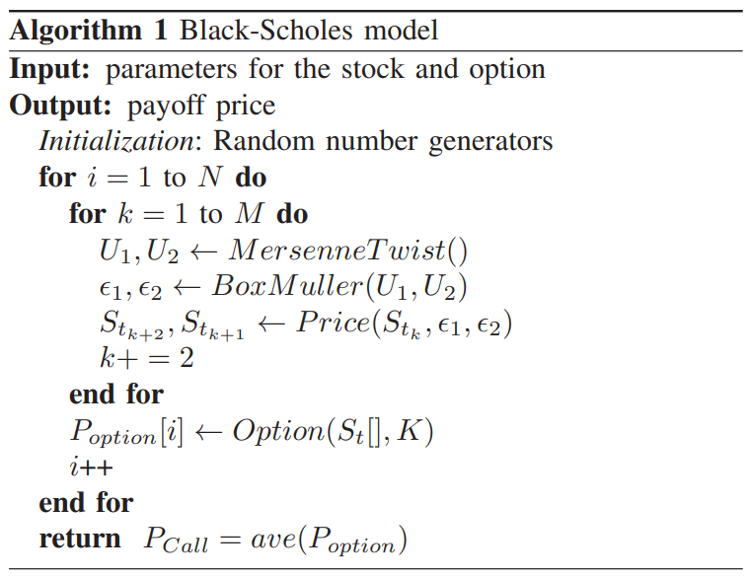
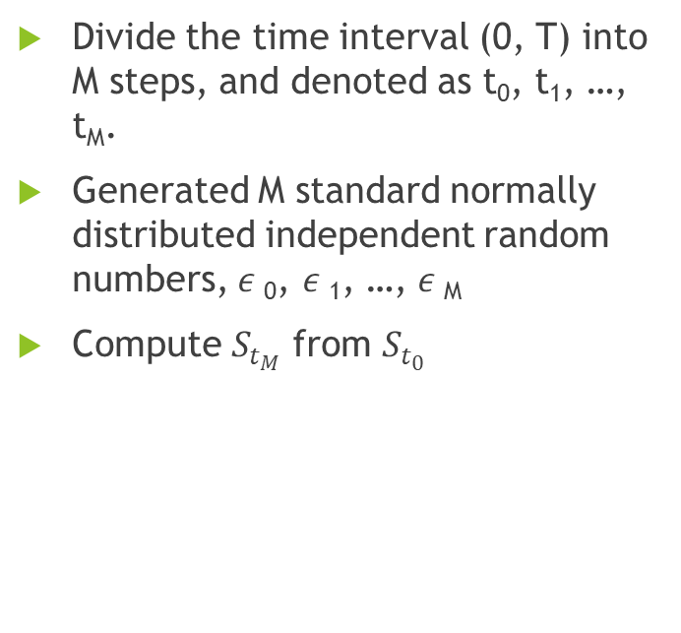
Algorithm
Divide the time interval (0, T) into M steps, and denoted as t₀, t₁, …, t_{M}.
Generated M standard normally distributed independent random numbers, $ε$₀, $ε$₁, …, $ε$_{M}
Compute $S_{t_{M}}$ from $S_{t_{0}}$
by

Slide 5
Hardware Structure
System Structure
Kernel Structure
Prepare parameters
Execute kernel
Check results
Platform setup
Parameter setup
Random number generation
Path simulation
Sum and determine the results
launchSim

Slide 6
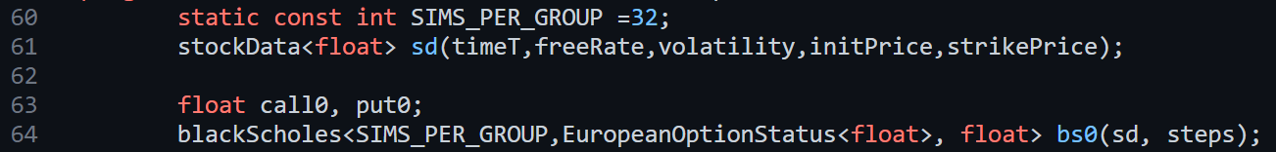
Kernel Execution Parameter Setup
Use the template class stockData to setup the required parameters.

Slide 7
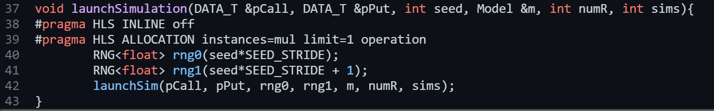
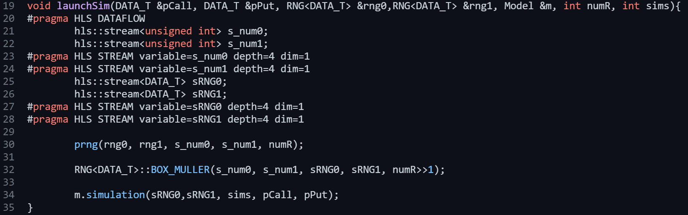
Kernel Execution LaunchSim
The workhorse of the algorithm is lauchSimulation

Slide 8
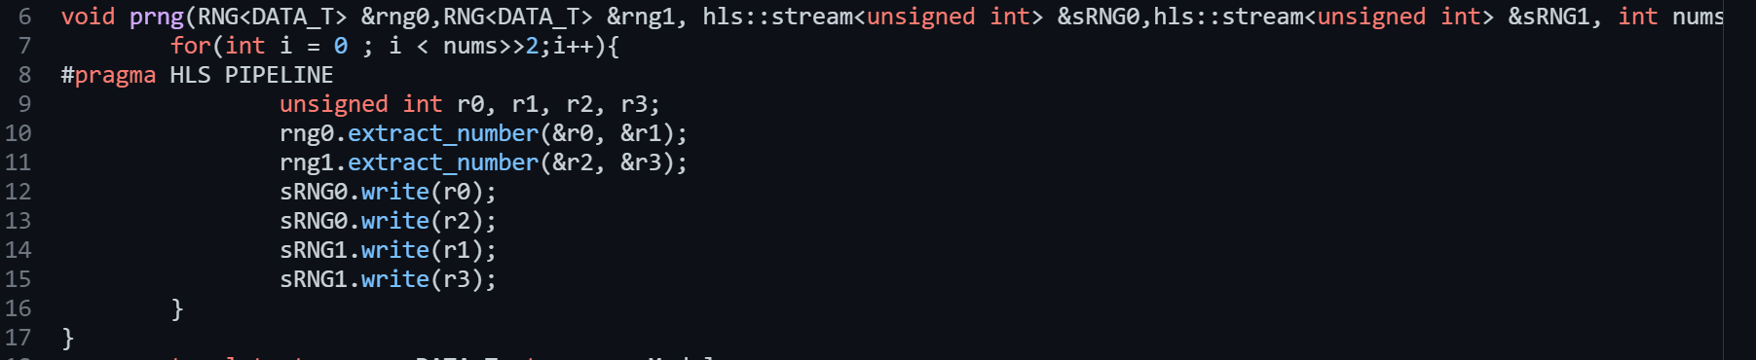
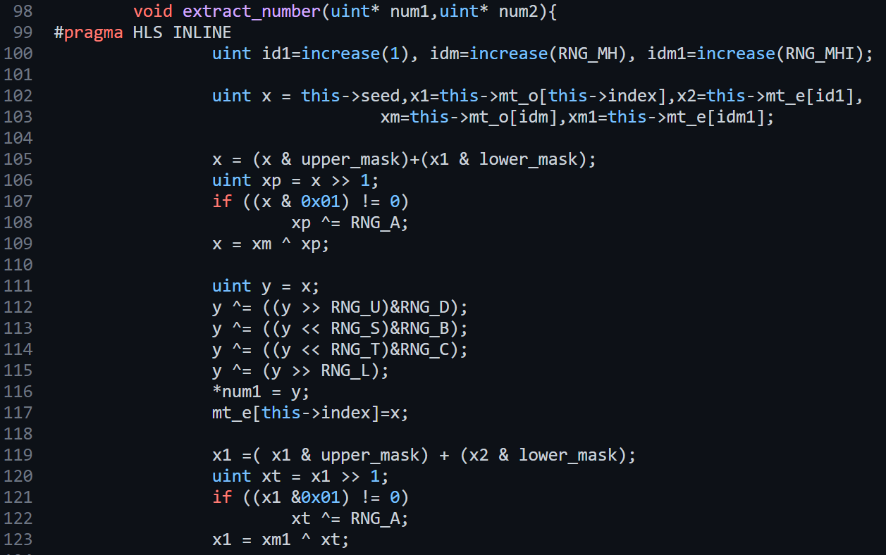
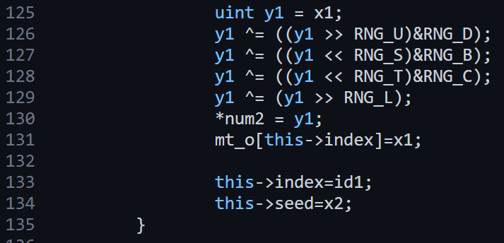
Kernel Execution LaunchSim
Prepare the seed

Slide 9
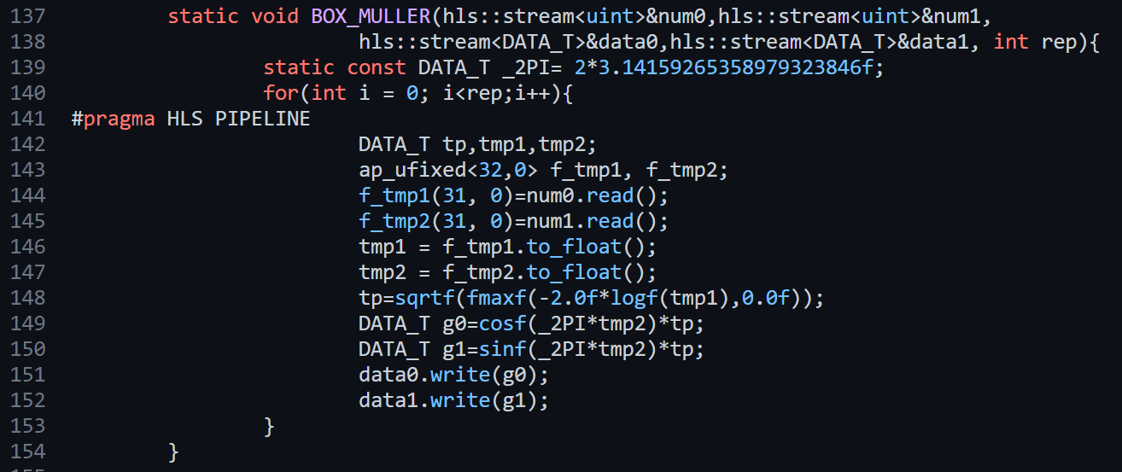
Kernel Execution LaunchSim
Box-Muller algorithm

Slide 10
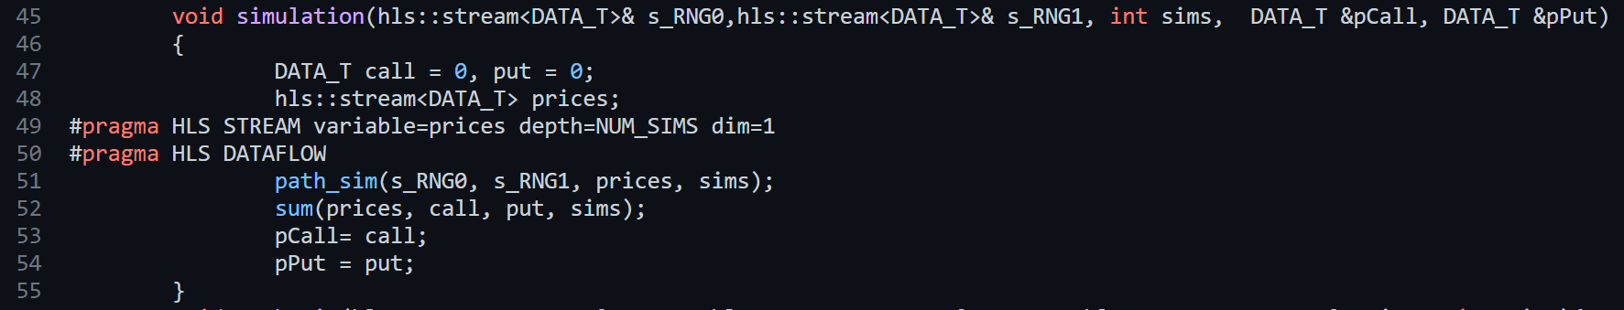
Kernel Execution LaunchSim
Run simulation

Slide 11
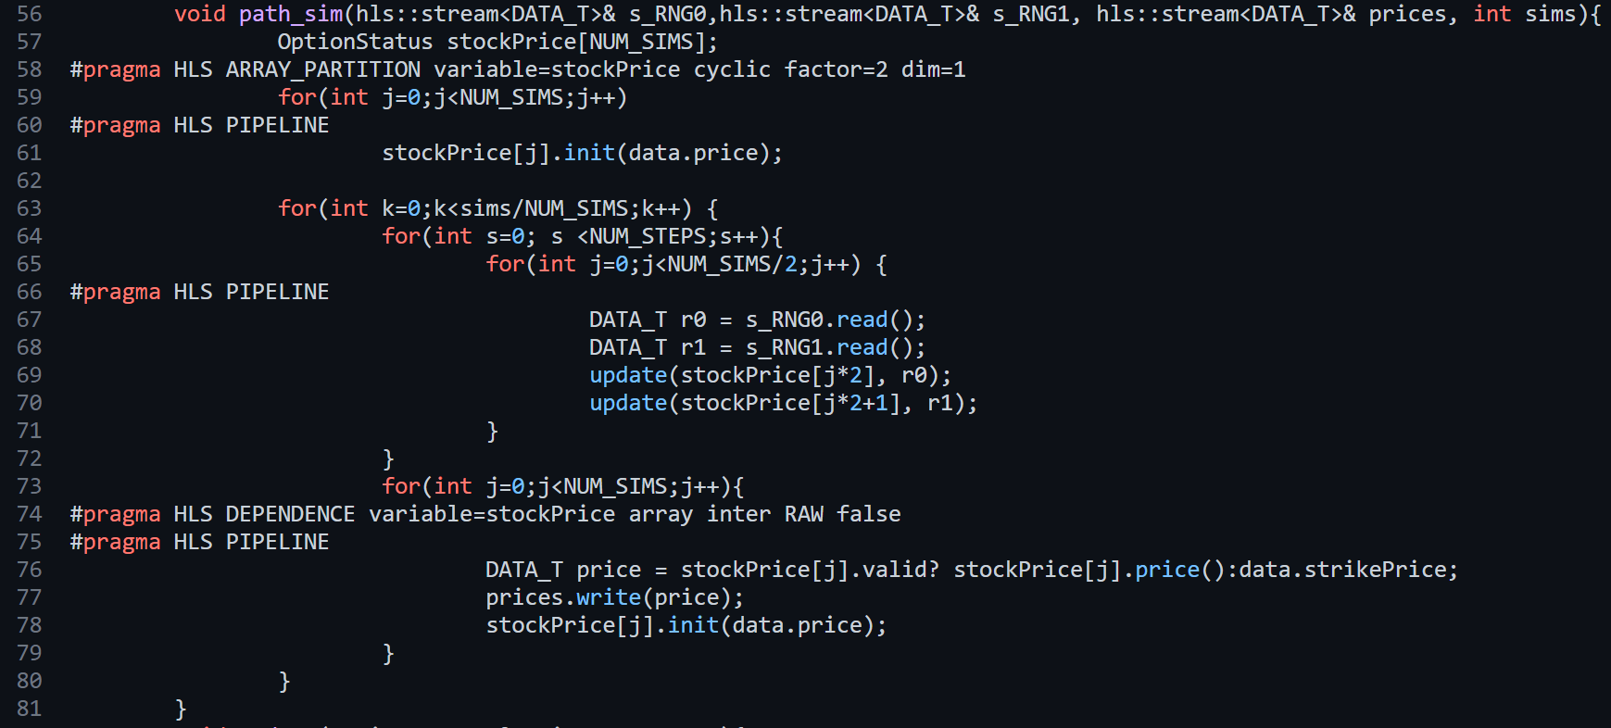
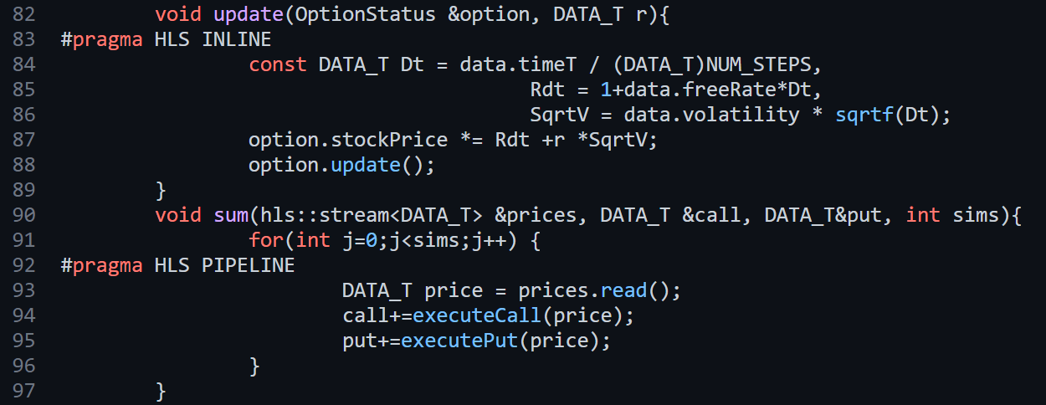
Kernel Execution LaunchSim
Black-Scholes Model

Slide 12
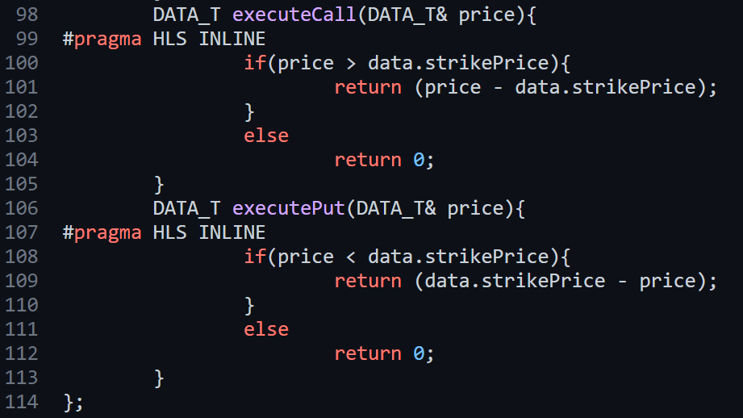
Kernel Execution LaunchSim
Determine final price

Slide 13
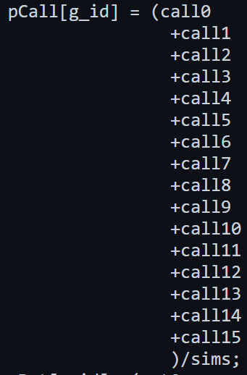
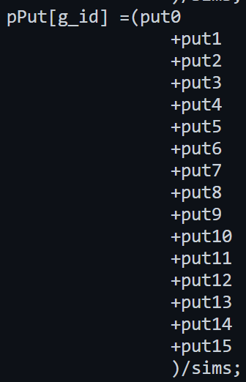
Kernel Execution Sum and Determine the result

Slide 14
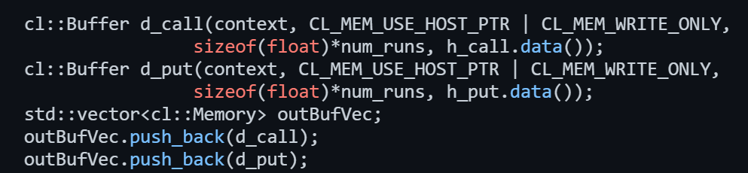
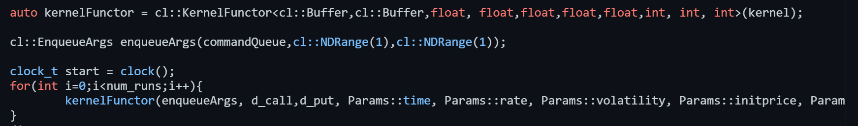
Origin Implementation Host

Slide 15
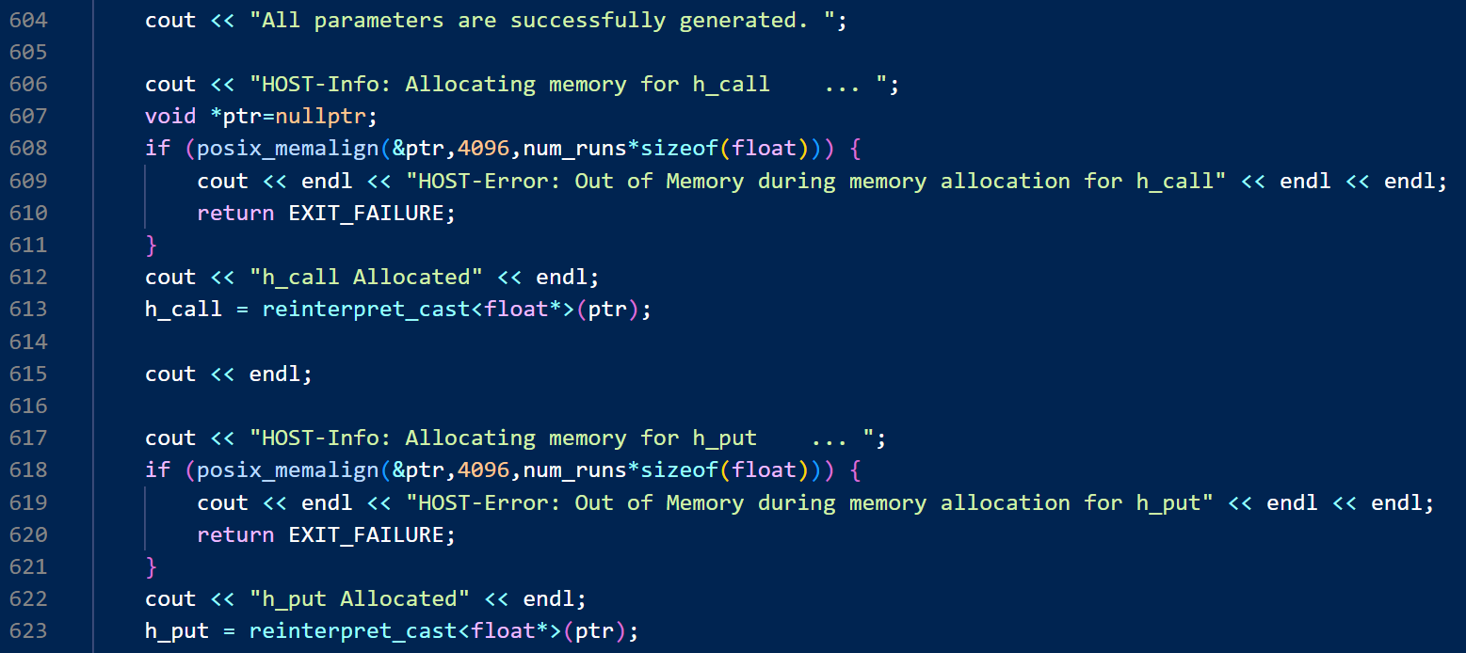
Implementation Host

Slide 16
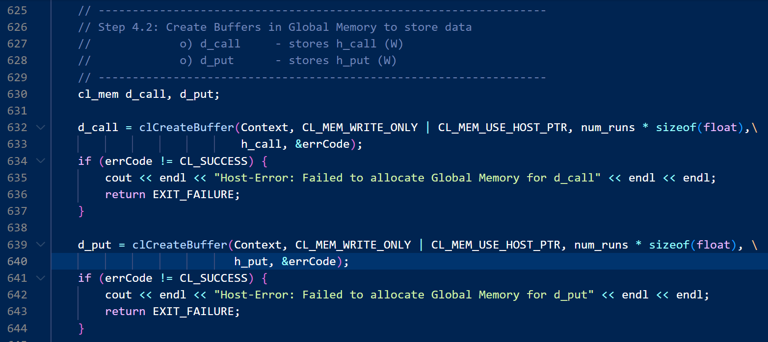
Implementation Host

Slide 17
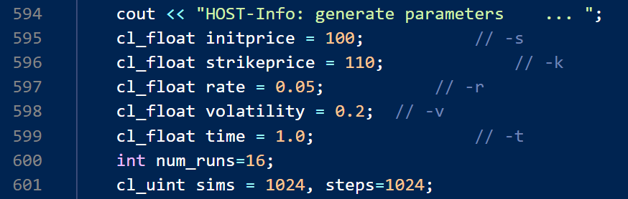
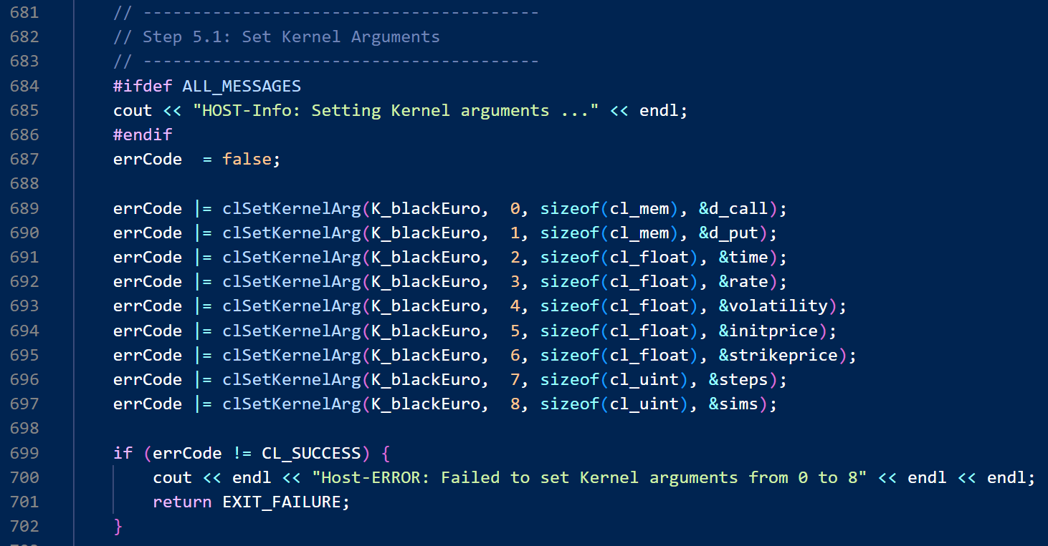
Implementation Host

Slide 18
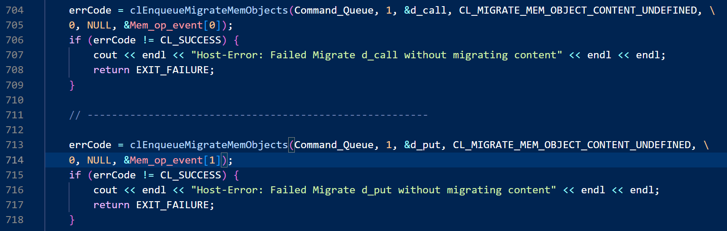
Implementation Host

Slide 19
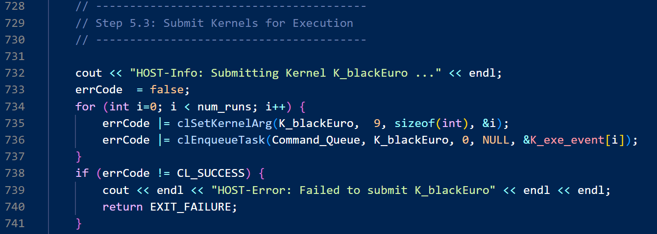
Implementation Host

Slide 20
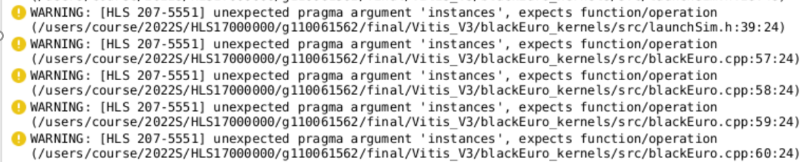
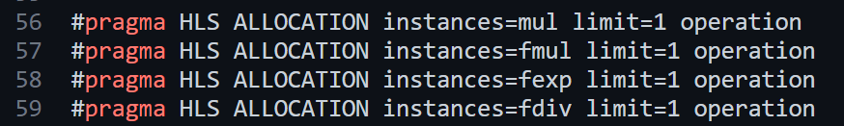
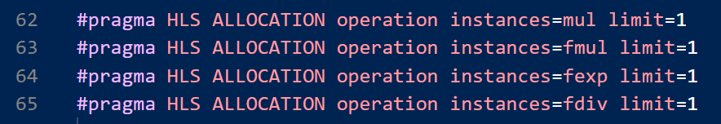
Implementation Kernel
Origin
Adjusted

Slide 21
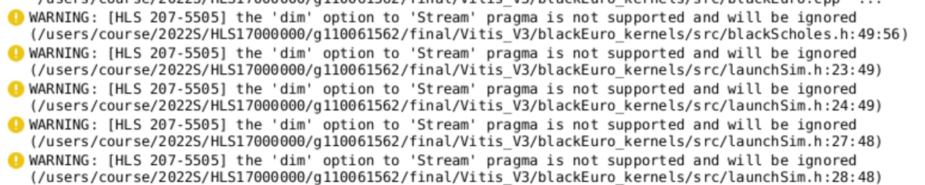
Implementation Kernel
Origin
Adjusted

Slide 22
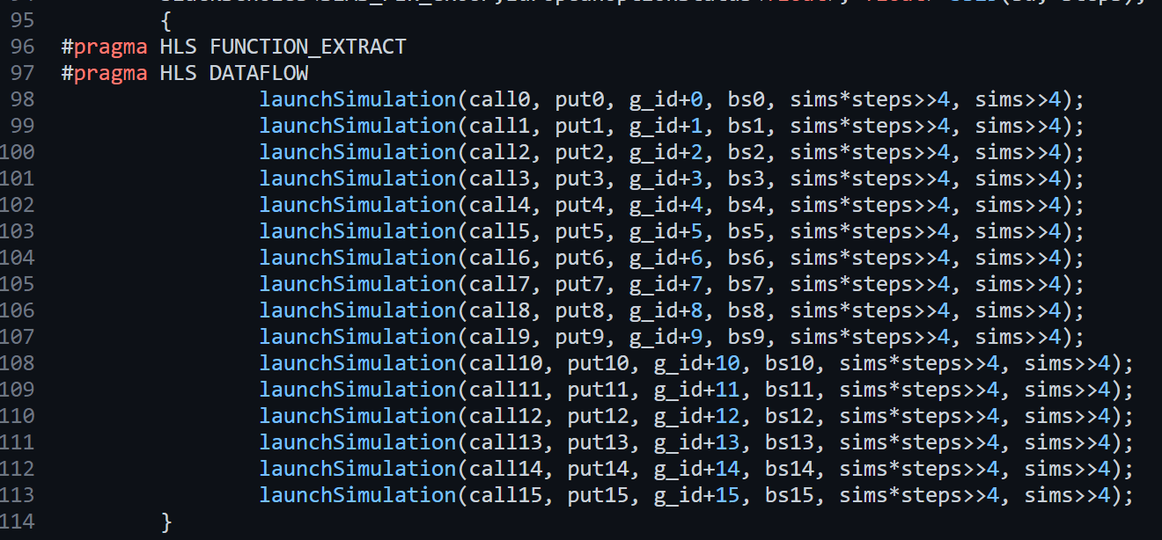
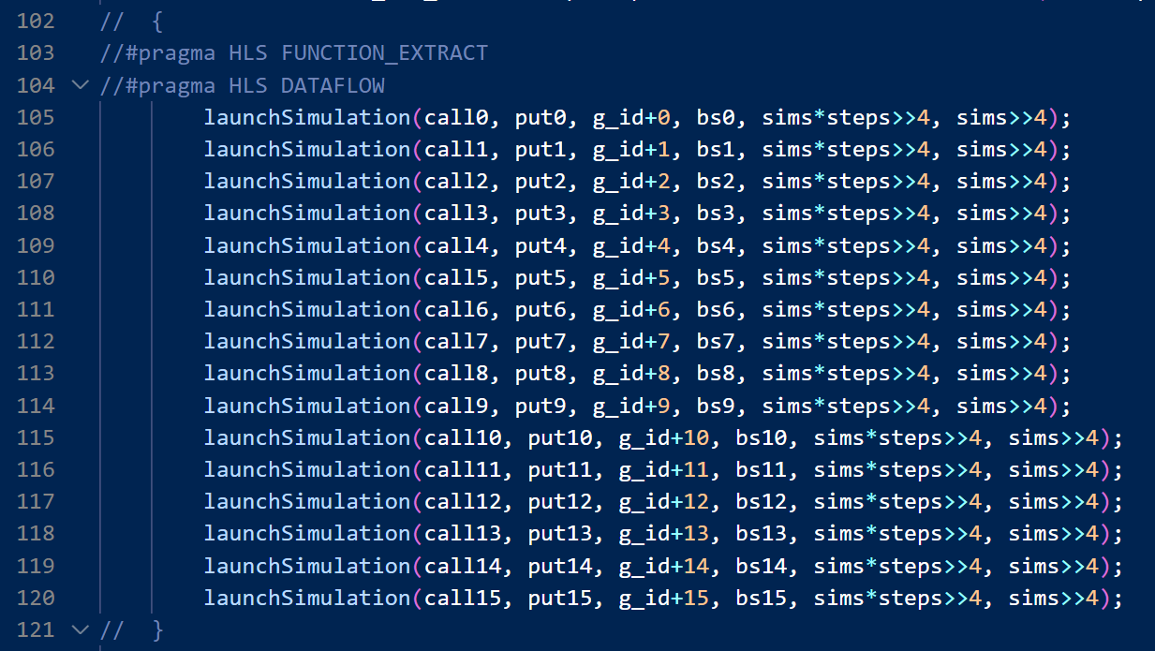
Implementation Kernel
Origin
Adjusted

Slide 23
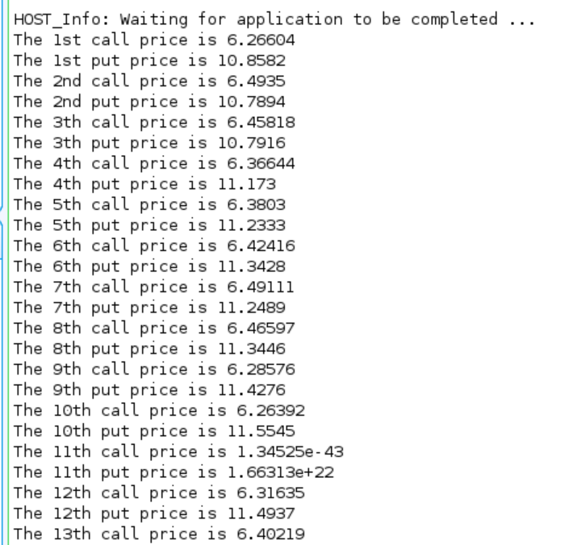
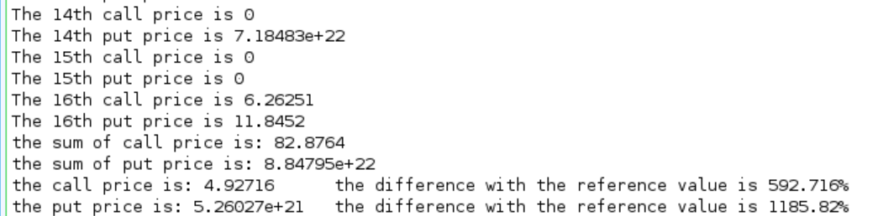
Result

Slide 24
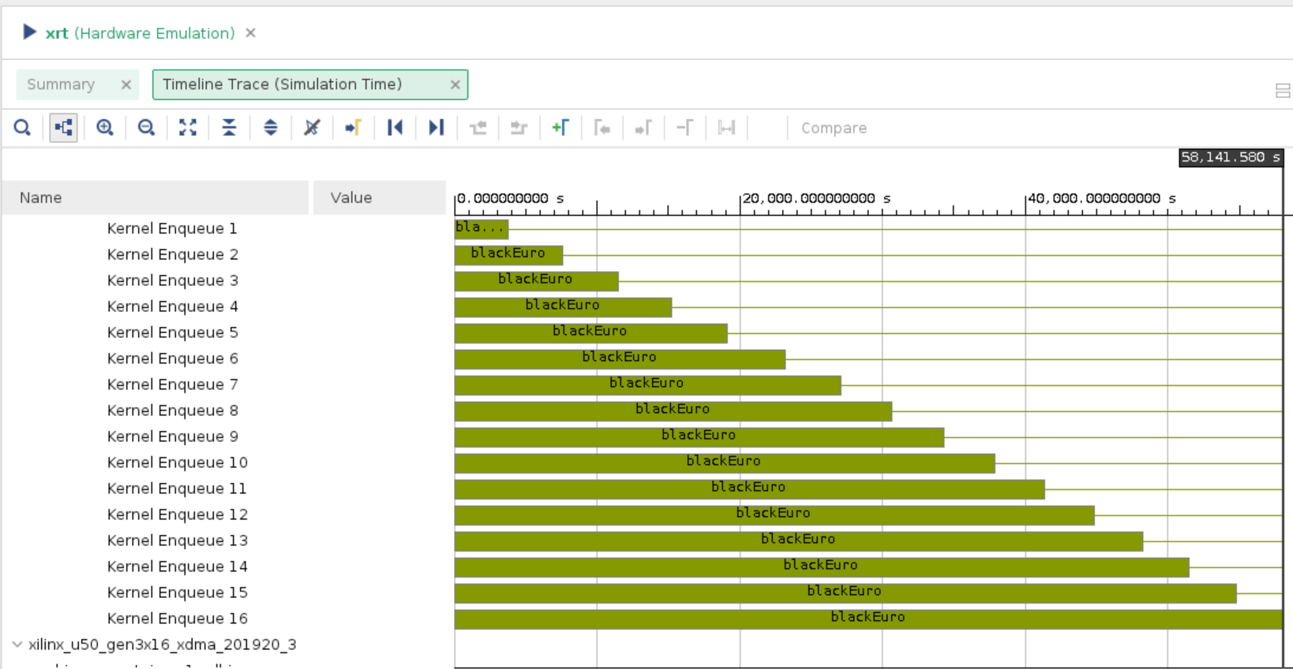
Hardware Emulation Timeline Trace

Slide 25
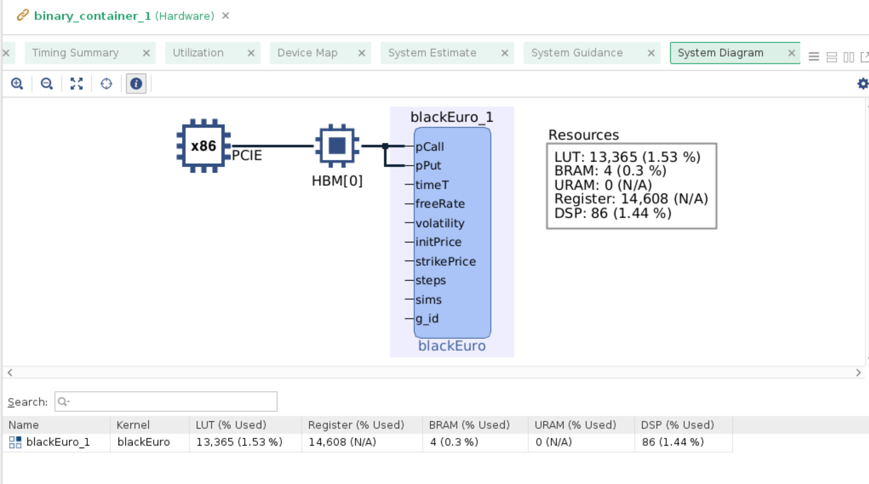
Hardware Utilization System Diagram

Slide 26
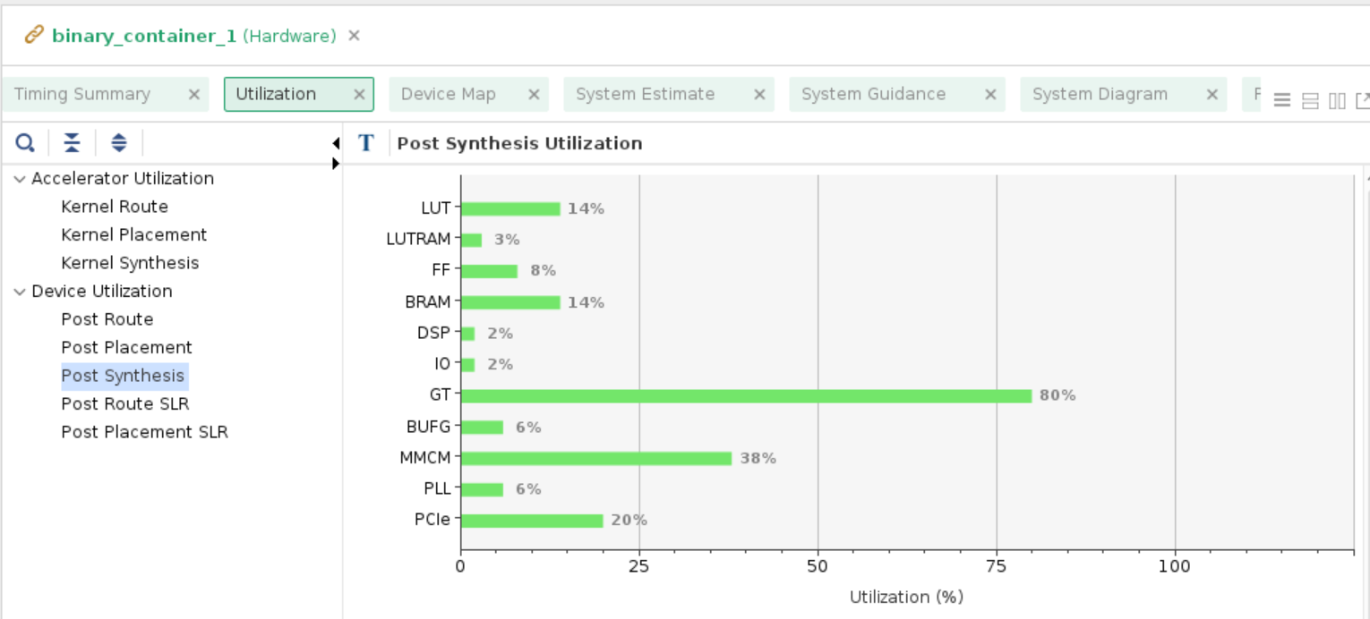
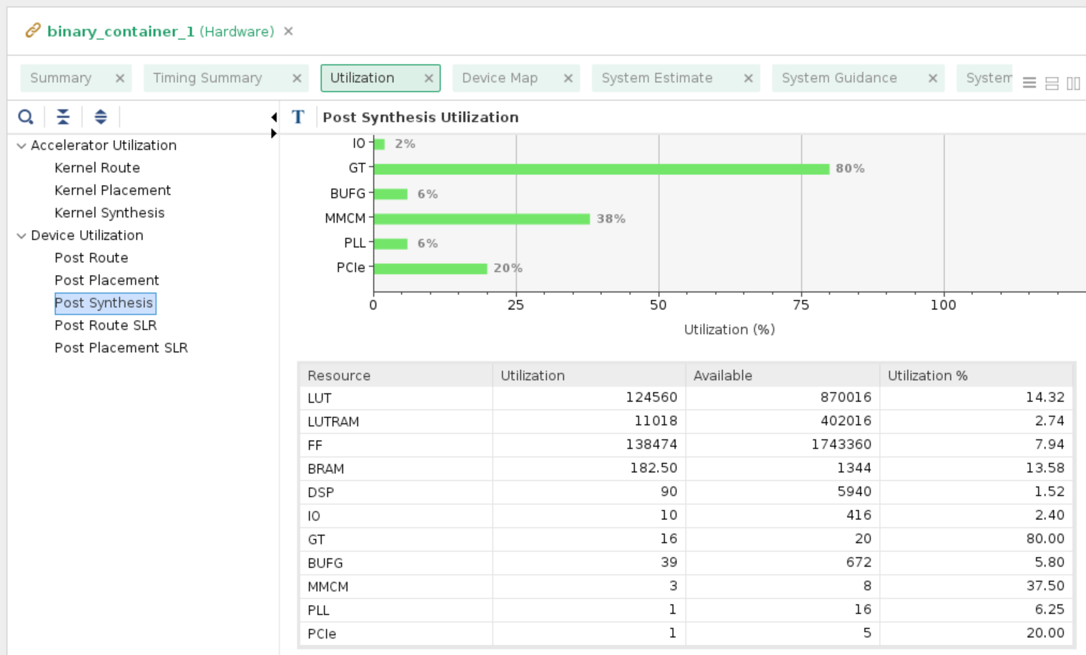
Device Utilization

Slide 27
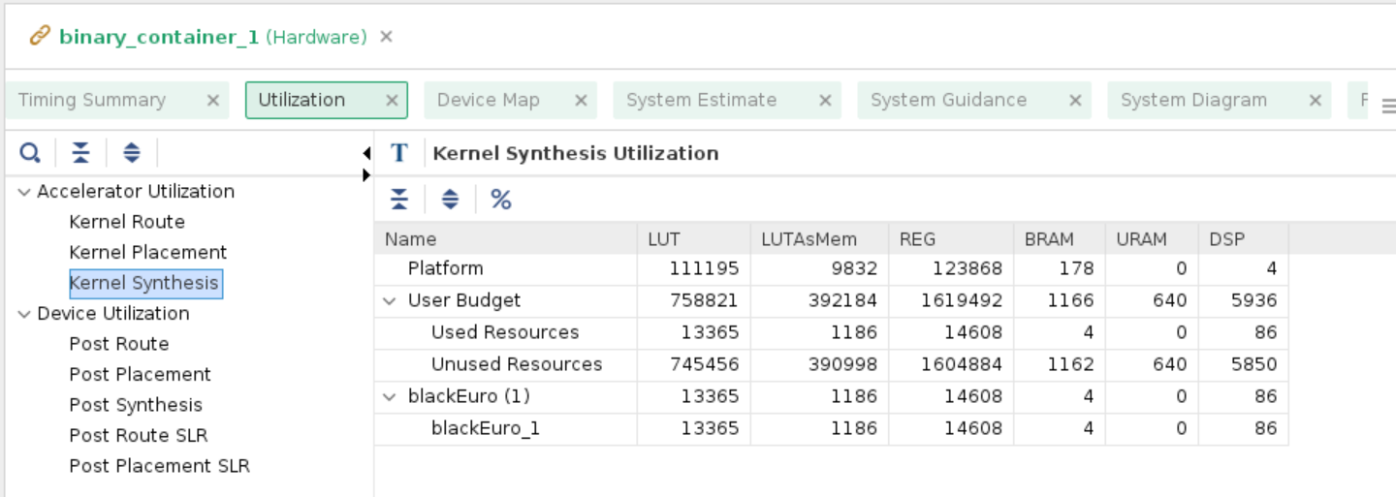
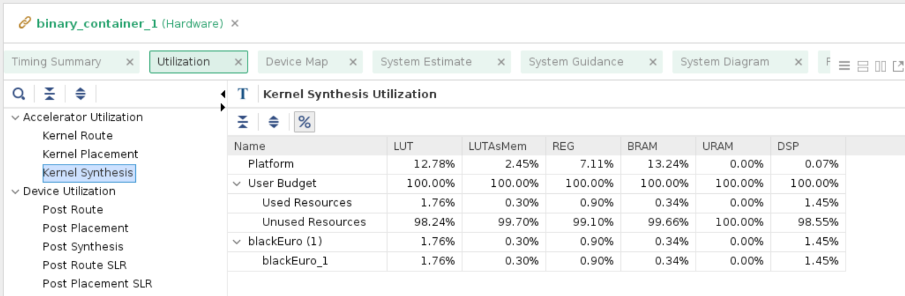
Accelerator Utilization

Slide 28
Reference
L. Ma, F. B. Muslim and L. Lavagno, "High Performance and Low Power Monte Carlo Methods to Option Pricing Models via High Level Design and Synthesis," 2016 European Modelling Symposium (EMS), 2016, pp. 157-162, doi: 10.1109/EMS.2016.036.
https://docs.xilinx.com/r/en-US/ug1399-vitis-hls/pragma-HLS-inline
https://docs.xilinx.com/r/en-US/ug1399-vitis-hls/pragma-HLS-allocation
https://www.boledu.org/textbooks/hls-textbook/io-interface/axi-lite
https://github.com/dr-liangma/FinancialModels_AmazonF1

